Slide 1
Digital Check-In System via Face Recognition
Presentation by Team Project 2
Members:
Name | Role
Reethu Karnati | Project Manager, Requirements Coordinator
Aditya Vardhan Bezawada | Development Coordinator
Akhil Bonthinayanivari | Test Coordinator
Tejasree Reddy Annapureddy | Configuration Coordinator

Slide 2
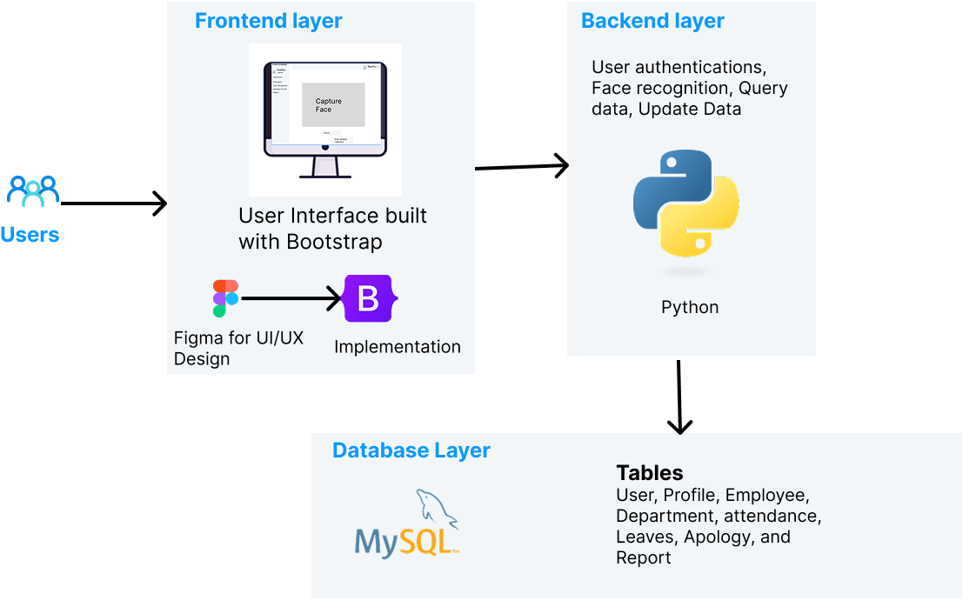
Technologies Used (Django Framework)
HTML, CSS, JavaScript, and Bootstrap for fronted.
Python for backend
MySql for database
OpenCV and face-recognition for face recognition
Figure 1 Technologies

Slide 3
Feature Implemented
1. Authentication: Admin and Employees can successfully login to the system
2. Employee Management (Add, Update, Delete)
Admin is able to add, update and delete employees
3. Department Management (Add, Update, Delete)
Admin is able to add, update and delete department.
4. Role-Based Access Control (RBAC): Employees log in to Employee Dashboard and Admins log in to Admin Dashboard.

Slide 4
Features Implemented
5. Profile Update
All the users of the system either admin or employ can update their profile.
6. Accessibility : Multilingual Support
The system can be translated to any different language of your choice.
7. Mobile Responsiveness
Our system is responsive to mobile and tablet view.

Slide 5
Project Links
Demo Link: https://digitalcheckinsystem.pythonanywhere.com/
Management Link: https://digitalcheckinsystemviaface.atlassian.net/
Code Link: https://github.com/AdityaVardhan7/DigitalCheckInSystem

Slide 6
Features Remaining for Next Demo
Facial recognition feature that we have started working on.
Attendance Management
Updating attendance via face recognition
Manual attendance entry
Analytics
Attendance trends and visualization
Reports
Exporting attendance reports
Apology & Leave Management

Slide 7
Thank You

